Slide 1
What the SIM open data can support
YCIT 440 CAPSTONE, EDA MILESTONE
Exploratory analysis for a one-day-ahead forecast of published interventions in Divisions 1-6
Team 4: Cristal Cortez, Isaac Abouganem, Peining Huang, Karl Moubayed, Langyue Sun
October 15, 2026
Notes:
About 30 seconds. Introduce the team and the milestone. One sentence on the project: we want to forecast, one day ahead, how many interventions the Montréal fire service (SIM) will record in each of its six operational divisions. This talk covers what we checked in the data, what we found, and what it means for the model.

Slide 2
One forecast per division, one day ahead
Decision supported
Review planned training or maintenance that takes units out of service when unusual volume is expected.
Target
Daily count of interventions published in the open data, per Division 1-6
Intended user
Unit | interventions per division-day
Timing | forecast day D on D−1, using counts up to D−3
Judged by | MAE and bias against a recent same-weekday mean
SIM Operational Planning Division (proposed; the decision owner is not confirmed).
Scope
Recorded volume, not workload: no claims about staffing, vehicles or response times.
Team 4, SIM interventions EDA
2
Notes:
About 1 minute. The decision: SIM sometimes takes units out of service for training or maintenance. A day-ahead forecast of volume per division could flag days when that is risky. The user is proposed, not confirmed. The target is the daily count of interventions published in the open data, for each of Divisions 1 to 6. Timing matters: the portal publishes about 2 days late, so a forecast made on D minus 1 can only use counts up to D minus 3. Success means a lower MAE than a recent same-weekday average. We forecast recorded volume, not workload.

Slide 3
754,413 incidents, 14,748 division-days
754,413
2,458
6
53
records in 2 appended files; 13 columns: 4 numeric codes, 1 timestamp, 4 text, 4 coordinates
observed days, 2020-01-01 to 2026-09-24
divisions in the target; division code 0 (600 rows) excluded
median interventions per division-day; no zero days
Division | Mean | Median | SD | Q1-Q3 | P95 | Max | Skewness
1 | 28.3 | 28 | 13.2 | 23-33 | 41 | 384 | 11.0
2 | 54.2 | 54 | 14.6 | 47-62 | 74 | 221 | 1.7
3 | 61.2 | 61 | 17.7 | 53-69 | 84 | 394 | 4.0
4 | 59.1 | 59 | 15.0 | 52-67 | 80 | 287 | 1.2
5 | 57.8 | 57 | 16.3 | 49-66 | 81 | 353 | 2.9
6 | 46.0 | 45 | 16.1 | 35-56 | 73 | 143 | 0.4
The typical day is symmetric
Mean and median agree within 1 in every division.
The tails are storm days
Division 1's maximum is 13 times its median. MAE, which targets the median, is the right metric.
Source: Ville de Montréal open data (CC BY 4.0), retrieved 2026-09-26
3
Notes:
About 1 minute 15. Two official files, 2020-2024 and the current file, same 13 columns, consecutive periods, so we append them. 754,413 records. We aggregate to one row per division per day: 14,748 division-days, median 53, never zero. The table describes the target. Mean and median agree, so a typical day is symmetric. The tails are not: Division 1 had 384 interventions on the ice-storm day, 13 times its median. That is why we use MAE as the primary metric and why we look at storm days separately.

Slide 4
Small, known gaps, each with a plan
Issue | Size | Planned handling
2024-12-31 missing from both files | 1 day | Kept as null, never 0; that day is not scored
Division code 0, undocumented | 600 rows | Excluded from the target
Blank incident group, mostly fire-type | 1,788 rows | Not in the target; counted as non-first-responder in share features
Date-only timestamps | 8 rows | Counted on their date
Duplicate (year, incident number) | 0 | Key is unique; the two files do not overlap
Coverage
Outliers
The open data hold about 94% of the interventions SIM reports (2022-2024), so the target is published interventions.
134 division-days (0.91%) flagged by robust STL residuals with z above 6. Kept, and evaluated with and without.
Leakage: day D's incident type, caserne and vehicles are known only after D, so they are never inputs. Lagged counts stop at D−3.
Team 4, SIM interventions EDA
4
Notes:
About 1 minute 30. Missing values are few and we know where they are. The important one is 2024-12-31: it is absent from both files, so it is a gap, not a quiet day. We keep it as null and never score a forecast for it. Division code 0 is undocumented and excluded. Blank groups grow over time and are mostly fire-type events. No duplicate keys. Coverage: the open data are about 94% of what SIM reports, so we say "published interventions". Outliers are flagged by a rule, not removed. Leakage: anything describing day D's incidents is unknown when we forecast, so it is never an input.

Slide 5
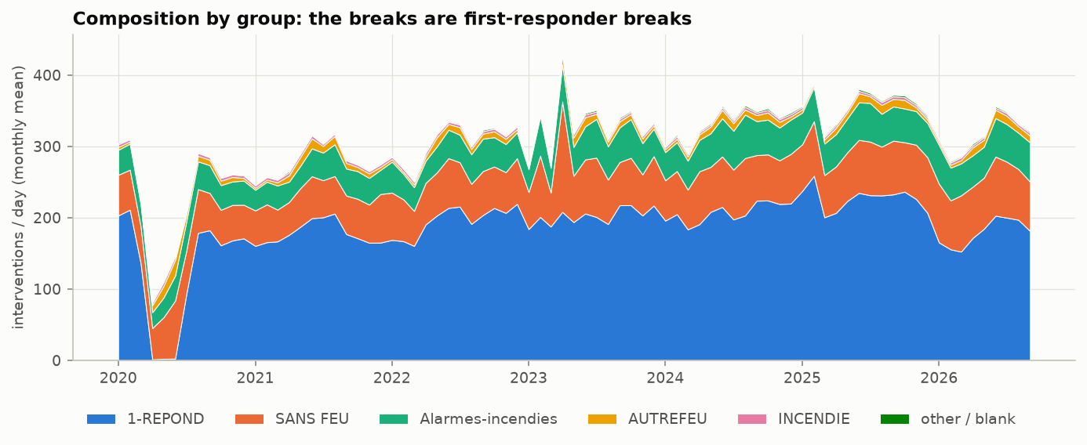
The level shifts with first-responder calls
227 to 358
interventions a day, citywide, 2020 (COVID) to 2025; flat in 2023-24
Spring 2020
first-responder calls nearly vanish for about three months
−25% to −30%
first-responder calls in Divisions 1-5, 2026 vs 2025, while Division 6 rose 9.5%. Cause not documented.
Train on 2021-2024, track the level with recent features, and treat 2025 onward as a drift test.
Team 4, SIM interventions EDA
5
Notes:
About 1 minute 15. First pattern: the level is not stable, and the breaks come from first-responder calls, the blue band. In spring 2020 they almost disappear for three months (COVID). From late December 2025 they fall 25 to 30% in Divisions 1 to 5, while all other groups hold or grow, and Division 6 grows. We do not know why; a change in dispatch protocol is a hypothesis, not a finding. For the model: 2020 is only lag history, structure is learned on 2021 to 2024, and the late-2025 break falls inside our test period, so it is a real drift test.

Slide 6
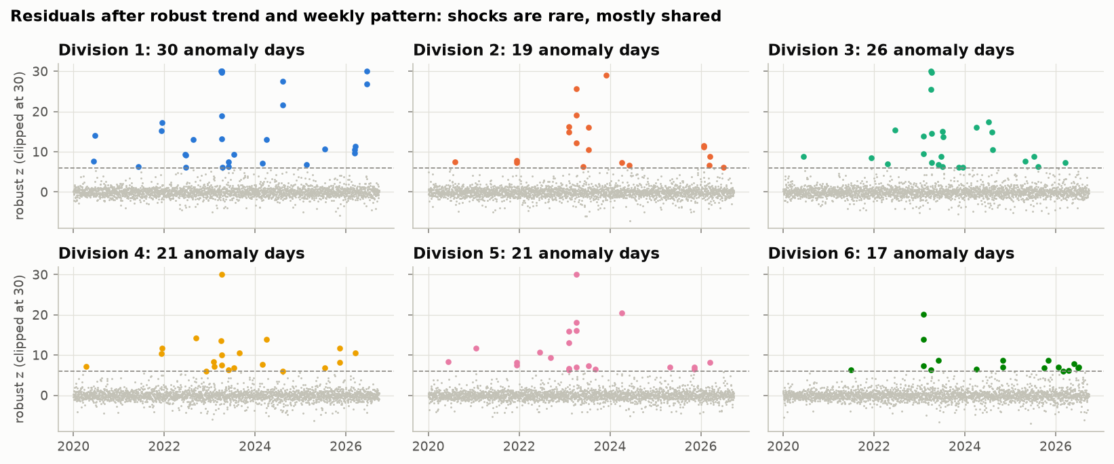
Shocks are rare, shared and weather-driven
0.91%
of division-days are anomalies: robust STL residual with z above 6
16 dates
anomalous in 3 or more divisions at once; the April 2023 ice storm peaked at 1,712 interventions
26% to 73%
non-medical calls on those days, against 21% overall: electrical problems and flooding
Neither the calendar nor counts up to D−3 predict them.
Team 4, SIM interventions EDA
6
Notes:
About 1 minute 15. Second pattern: shocks. We remove each division's trend and weekly pattern with a robust decomposition, then flag days whose residual is more than 6 robust standard deviations above normal. That flags under 1% of division-days. Most of them happen on the same dates in several divisions: 16 dates hit 3 or more divisions at once. Those are weather days. The April 2023 ice storm is confirmed; the others match electrical problems and flooding but we have not checked them against weather records. Nothing in our inputs predicts them, so we report errors with and without these days.

Slide 7
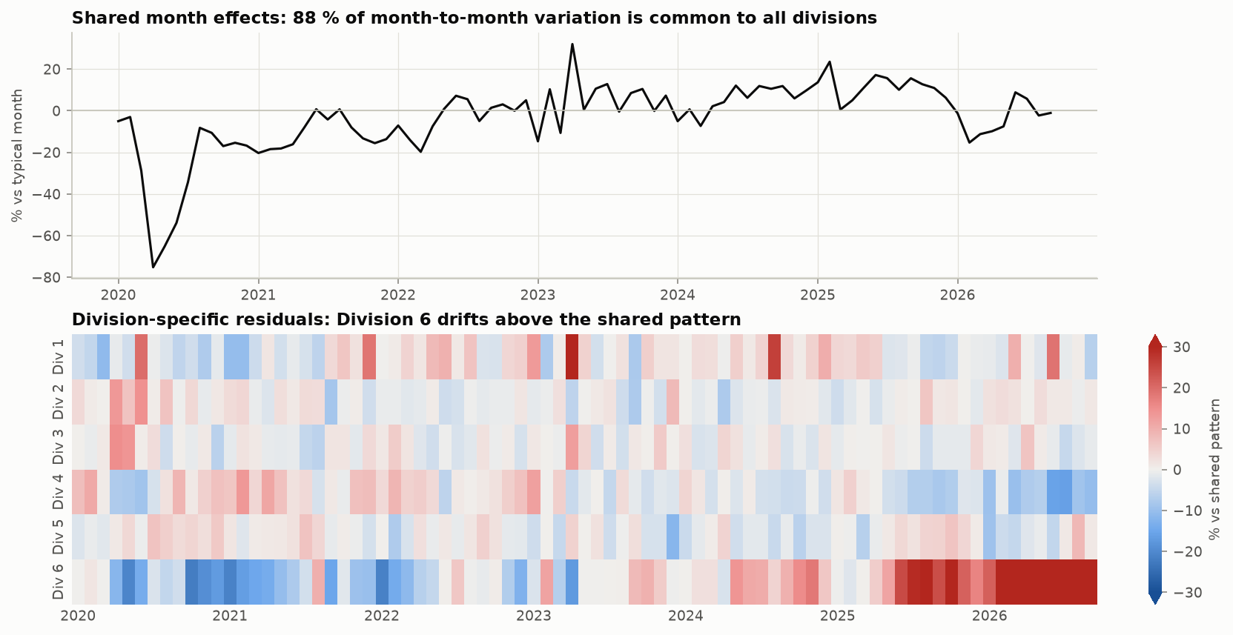
Divisions move together, except Division 6
88.5% of month-to-month variation is shared by all six divisions. Division 6 sits 44% above the shared pattern in 2026, up from about 10% below it in 2020-21.
Team 4, SIM interventions EDA
7
Notes:
About 1 minute. Third pattern: do the divisions move together? We decomposed the division by month table with a median polish, which resists storm months. Once each division's size is removed, 88.5% of the month-to-month movement is common to all six: COVID, the ice storm, the 2025 high. The bottom heatmap is what is left for each division. Division 6, downtown, is the exception: it climbs to 44% above the shared pattern in 2026. Daily residuals agree: Divisions 1 to 5 correlate 0.39 to 0.64 with each other, Division 6 only 0.14 to 0.34.

Slide 8
What this means for planning
Volume is not workload
First-responder calls are 61% of incidents but 36% of vehicles. The forecast counts interventions, not the crews they need.
The riskiest days are shared
Storms hit several divisions at once, when units out of service hurt most. A count-only forecast will miss them; weather forecasts might (hypothesis).
Divisions differ
Division 6 grew while Divisions 1-5 fell. Splitting a citywide forecast by fixed shares would under-forecast it.
Team 4, SIM interventions EDA
8
Notes:
About 1 minute. What the findings mean for SIM's planners. One: we forecast volume, not workload. First-responder calls are most of the incidents but use few vehicles, so the forecast cannot tell planners how many crews they need. Two: the riskiest days are storm days that hit several divisions at once, which is exactly when taking units out of service is most costly. Our count-only design will not anticipate them; adding weather forecasts might, but that is a hypothesis and outside the agreed design. Three: Division 6 behaves differently, which justifies forecasting each division rather than splitting a citywide number.

Slide 9
What this means for the model
Build the model
Judge the model
Features
Split
Recent levels ending D−3, weekday, month, holidays. No linear trend: it over-predicts after December 2025. Never incident type or vehicles.
Rolling-origin validation on 2021-2024, test on 2025 onward. No k-fold cross-validation: it would train on the future.
Structure
Baselines
One pooled model with a division effect, since most movement is shared. Division 6 gets its own recent-level features.
Same-weekday mean, 13 or 26 weeks: MAE 8.16. Plain 28-day mean: MAE 8.03, the harder comparator. We report both.
Target and loss
Evaluation
Poisson or Tweedie objective on raw counts, or log1p, chosen on validation MAE and always scored on the original scale.
MAE and bias per division and per month, with and without the 134 anomaly days.
Team 4, SIM interventions EDA
9
Notes:
About 1 minute 15. Left, how we build it. Inputs are recent levels up to D minus 3 plus the calendar; we drop the linear trend because it over-predicts after the late-2025 drop; nothing describing day D's incidents goes in. One pooled model across divisions, because most movement is shared, with extra level features for Division 6. Counts are over-dispersed, so we compare a Poisson or Tweedie loss with a log transform. Right, how we judge it. Time-ordered validation, never k-fold, which would train on days after the ones it predicts. Two baselines: the agreed same-weekday mean, and a plain 28-day mean, which was already better in 2024. Errors per division, per month, with and without anomaly days.

Slide 10
Next steps, risks and assumptions
Next steps
Risks and assumptions
Baseline and rolling-origin validation harness that enforces the D−3 cutoff
Feature pipeline: recent levels, calendar, holidays
Single models: LightGBM, XGBoost, CatBoost and a negative-binomial GLM
Ensemble, compared with both baselines using paired bootstrap intervals
The late-2025 first-responder drop has no documented cause; a dispatch-protocol change is only a hypothesis
The D−3 cutoff is simulated: the portal keeps no history of publication dates
The open data cover about 94% of SIM activity
Weather drives the surges but is outside the agreed design
Usefulness to SIM planners is unverified without access to SIM
Team 4, SIM interventions EDA
10
Notes:
About 45 seconds. Next: a baseline and validation harness that enforces the D minus 3 cutoff, then features, then single models, then the ensemble, compared with both baselines using bootstrap intervals so a small win is not over-claimed. Risks: we do not know why first-responder calls dropped in late 2025; the publication cutoff is simulated because the portal keeps no history; the open data are a subset; weather drives the surges but is outside the agreed design; and we cannot confirm that SIM planners would use this forecast.

Slide 11
Backup: 2024 baseline preview by division
Division | 4 wk | 8 wk | 13 wk | 26 wk | 52 wk | Plain 28-day | Best
1 | 6.58 | 6.01 | 5.94 | 6.01 | 6.23 | 5.92 | Plain 28-day
2 | 8.85 | 8.42 | 8.27 | 8.21 | 8.43 | 8.04 | Plain 28-day
3 | 11.05 | 10.05 | 9.95 | 9.61 | 9.81 | 9.73 | 26 wk
4 | 9.08 | 8.31 | 8.21 | 8.17 | 8.25 | 7.88 | Plain 28-day
5 | 9.54 | 8.89 | 8.66 | 8.81 | 8.95 | 8.67 | 13 wk
6 | 8.23 | 7.91 | 7.93 | 8.12 | 8.13 | 7.91 | 8 wk and plain (tie)
All | 8.89 | 8.26 | 8.16 | 8.16 | 8.30 | 8.03 | Plain 28-day
Bias, all | −0.17 | −0.22 | −0.39 | −0.69 | −0.63 | −0.18
MAE in interventions a day on the 2024 validation year. The week columns are same-weekday means over that many weeks. Every forecast uses only data up to D−3; the 2025 test period was not touched. A feasibility check, not the final window choice.
Team 4, SIM interventions EDA
B1
Notes:
Backup, for questions about the baselines. Same-weekday windows of 13 and 26 weeks tie overall at 8.16; the plain 28-day mean is 8.03 and wins or ties in four of six divisions. Negative bias means slight under-forecasting in a rising year.

Slide 12
Backup: days anomalous in 3 or more divisions
Date | Divisions | Citywide | Non-medical
2023-04-06 | 6 | 1,712 | 72.6%
2024-04-04 | 6 | 736 | 53.8%
2021-12-11 | 5 | 550 | 54.0%
2023-02-04 | 5 | 697 | 41.9%
2023-02-05 | 5 | 728 | 49.0%
2023-04-05 | 5 | 950 | 64.8%
2023-04-07 | 5 | 930 | 52.5%
2023-07-13 | 5 | 701 | 50.9%
Date | Divisions | Citywide | Non-medical
2026-03-17 | 5 | 513 | 47.3%
2021-12-12 | 4 | 499 | 52.7%
2023-04-08 | 4 | 639 | 41.0%
2023-06-01 | 4 | 524 | 26.2%
2020-06-11 | 3 | 324 | 69.8%
2022-06-16 | 3 | 593 | 42.7%
2024-08-10 | 3 | 600 | 45.5%
2025-07-13 | 3 | 550 | 35.9%
Citywide = interventions that day; non-medical = share of SANS FEU calls (21% overall). Only the April 2023 ice storm is confirmed against a source; the other dates match weather patterns but are unverified.
Team 4, SIM interventions EDA
B2
Notes:
Backup, for questions about which days were flagged. 2020-06-11 is a good example of why we detect on residuals: 324 interventions looks ordinary, but it was 70% non-medical during the COVID low.

